Slide 1

ODBC2KML Project Demo
PolyTech Industries, Inc.
April 13, 2010

Slide 2
Project working structure
Two weekly group meetings
Weekly reports are submitted explaining the progress made duringthat week
Used to keep track of project schedule and time management
Log is maintained for every activity in the group

Slide 3
Impacts of this course
Every document goes through multiple revisions
Helps students understand whole SE process
Builds a good working team relationship
The project forces students to think and work on certain things that they have not covered in courses
Gives them a real world development experience

Slide 4
The Team

Slide 5
The Hours

Slide 6
Agenda
Project Overview
Major Functionality
Technical Design
Interface Design
Project Demo
Questions

Slide 7
Why ODBC2KML?
Current situation: manually generating KML from ODBC databases
Solution: create a system that automates the KML generation

Slide 8
Project Overview
Connect to a database
Map database field(s) to KML field(s)
Latitude/Longitude
Placemark Name
Insert Field Values into Description
Generate KML

Slide 9
Major Functionality
Create Connection
Edit Connection
Delete Connection
Generate KML File
Web Service
Web Application
Preview KML in browser by Google Earth Plugin

Slide 10
Technologies Used
ASP.NET 2.0
C#.NET
JavaScript/Ajax
Microsoft SQL Server Database

Slide 11
Technical Design
Core ODBC2KML classes
ODBC Database Connections
Public facing Web Pages
KML Generation Web Service

Slide 12
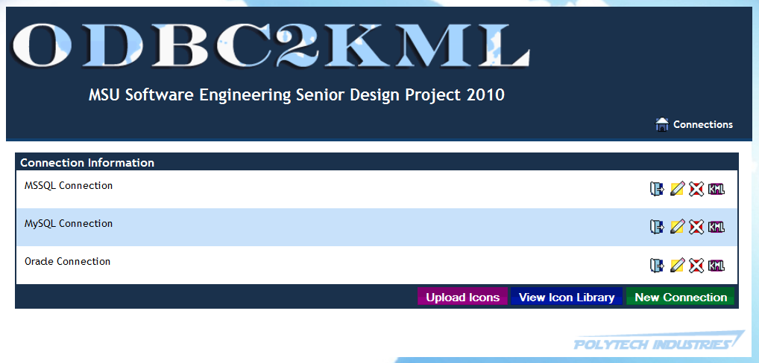
Design – Main Page

Slide 13
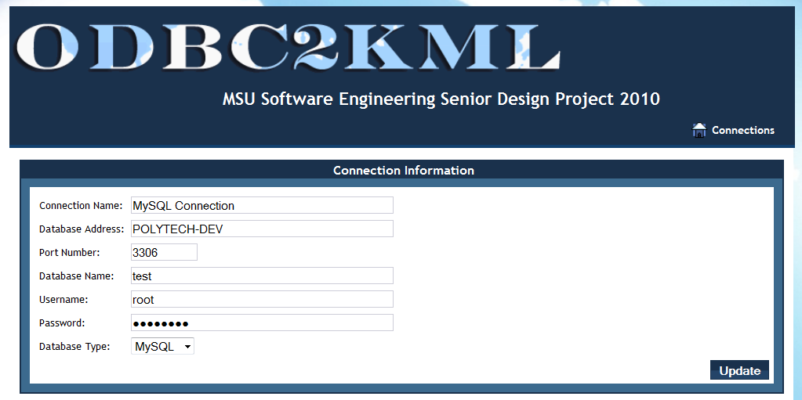
Design – ConnDetails: ConnInfo

Slide 14
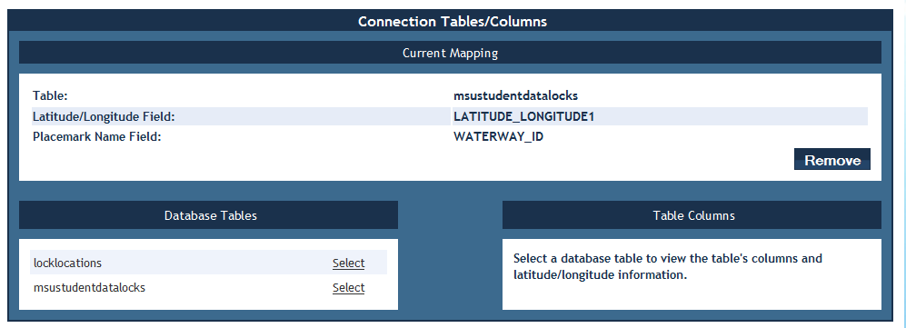
Design – ConnDetails: Mapping

Slide 15
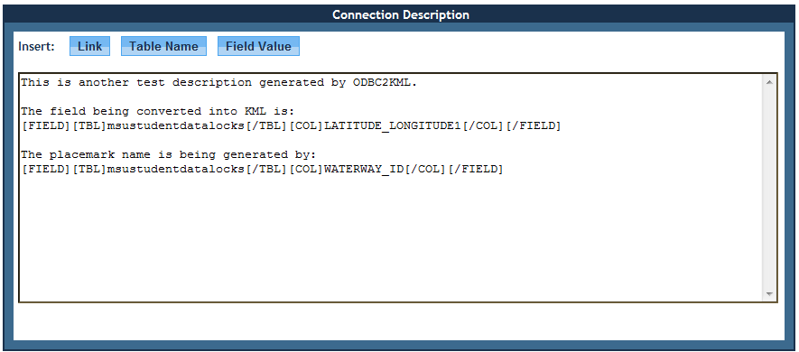
Design - ConnDetails: Description

Slide 16
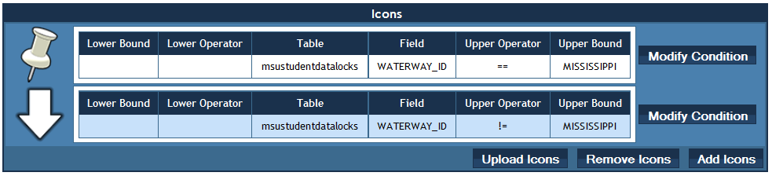
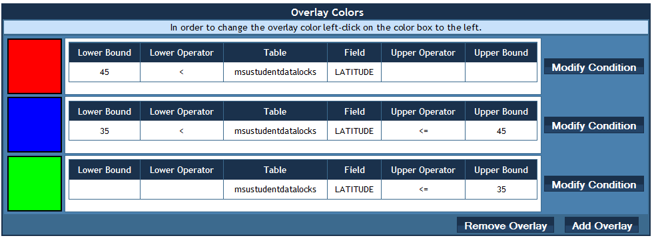
Design – ConnDetails: Icons and Overlays

Slide 17
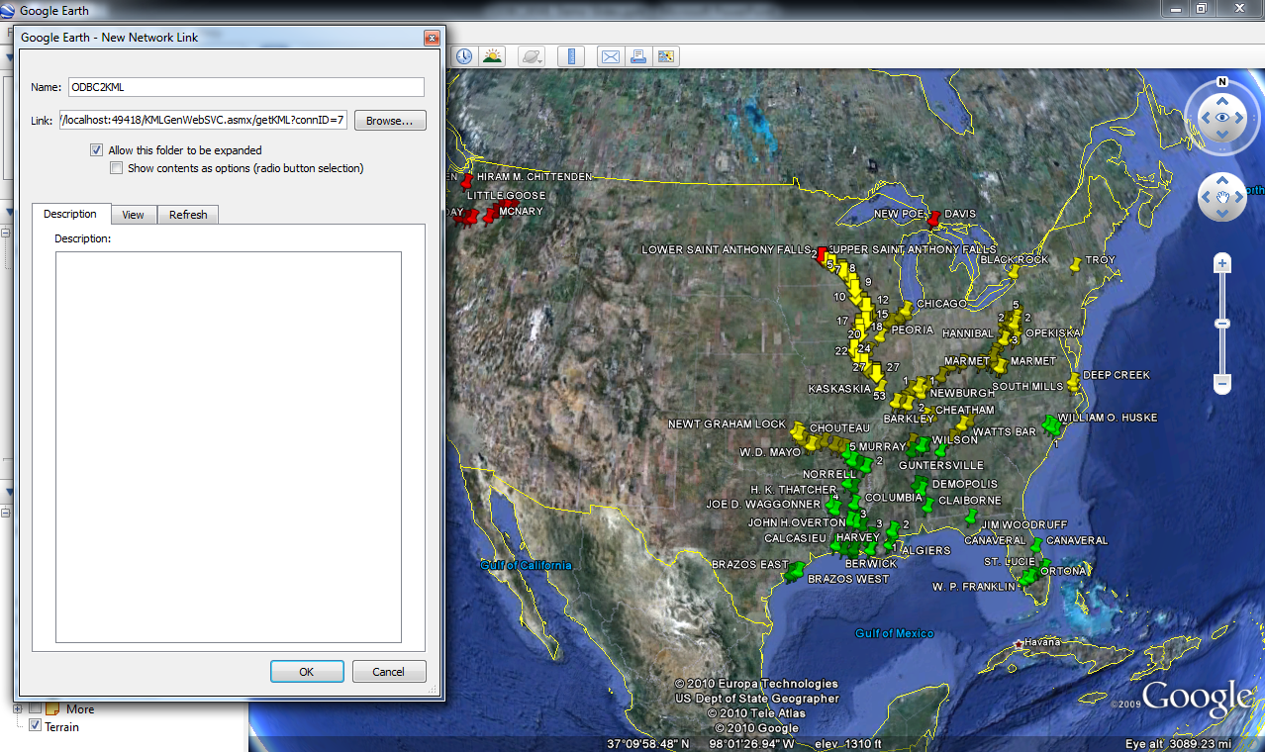
Design - KMLGenWebSVC

Slide 18
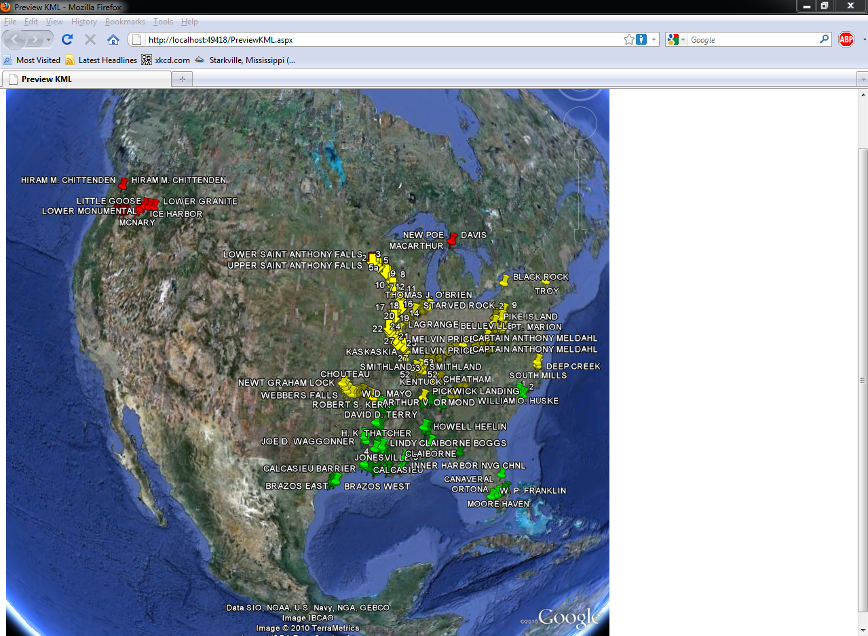
Design – Preview KML

Slide 19
Requirements and Design Questions?

Slide 20
Demo Hardware Setup
ODBC2KML in VM
Client Laptop
Remote Data Source in VM

Slide 21
Demo

Slide 22
Questions?

